Slide 1
VASFAA Annual Meeting
May 8, 2020
“From east of the East-est to west of the West-est we’ve searched the whole world just to bring you the best-est.”

Slide 2
Approval of May 8, 2019 Annual Meeting Minutes
“Sometimes you’ll never know the value of something, until it becomes a memory.”

Slide 3
Secretary’s Report
"It's not about what it is, it's about what it can become."

Slide 4
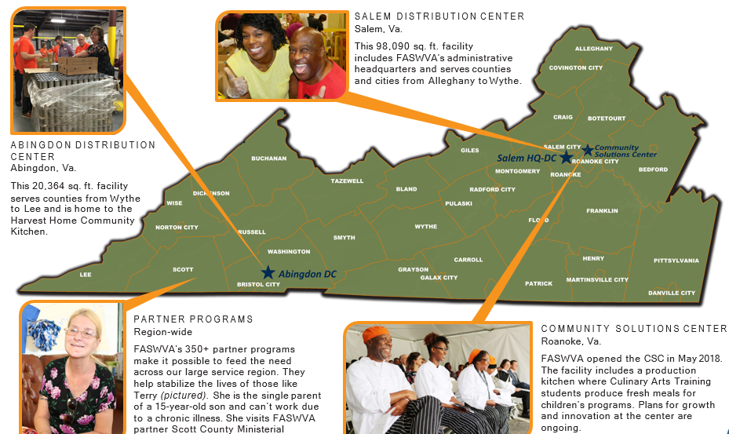
Charity Results
“Unless someone like you cares a whole awful lot, nothing is going to get better. It’s not.”
Feeding Southwest Virginia

Slide 5
President’s Report
“You have brains in your head. You have feet in your shoes. You can steer yourself any direction you choose.”

Slide 6
Treasurer’s Report
“Today you are you! That is truer than true! There is no one alive who is you-er than you!”

Slide 7
Awards
“And will you succeed? Yes you will indeed! (98 and ¾ percent guaranteed.)

Slide 8
State Update
Lee Andes, SCHEV

Slide 10
Federal Update
Will Shaffner, MOHELA

Slide 11
Agenda PAST – HEA through March 2020 CURRENT – COVID-19 Response FUTURE – Stimulus/Election/COVID-19 Resurgence/Other

Slide 12
HEA – March 2020
REA was slowly moving forward
Glimpse of bipartisanship
“…if anyone can get an agreement in this political environment, it’s Lamar and Patty...”
October 2019 College Affordability Act
House Republicans revise PROSPER Act
White House/U.S. DoE release General Principles

Slide 13
COVID-19 Response
Phases #1, #2, #3, and #3.5 are reactionary
Phases #1, and #2 – healthcare, testing, expansion of leave and was House led
Phase #3, and #3.5 – economic challenges from COVID-19, Targeting aid relief and was Senate led

Slide 14
Stimulus/Election/COVID Resurgence/Other items
Phase #4 – still COVID-19 reactions but also economic recovery and will be House led
Multiple “other” pressures
Election places additional pressures
What impact will COVID-19 have on move to distance education
Policy guidance from ED
Appropriations
**ACTION ITEM** to define and advocate for additional Administrative Relief (i.e. R2T4, LEU. Etc.)

Slide 15
2020-2021 Election Results
“Today is your day, your mountain is waiting. So get on your way!”

Slide 16
Adjournment “The more that you read, the more things you will know. The more that you learn, the more places you’ll go.”
Upcoming Events:
5/15 – Webinar: Income Earned from Work Deep Dive @ 2PM
5/15 – VASFAA Happy Hour @ 4PM
5/29 – VASFAA Happy Hour @ 4PM
6/4 – Webinar: 2019 & 2020 Tax Issues for Financial Aid Officers @ 2PM
6/12 – VASFAA Happy Hour @ 4PM
6/26 – VASFAA Happy Hour @ 4PM
4/10 -4/14/2021 – Annual Conference @ Marriot Virginia Beach Oceanfront

